Slide 1

Communicate Effectively
Notes:
Throughout the Wood Badge course, there are many opportunities to discover more about ourselves, share similarities with patrol members, and value the differences in others. Effective communication techniques are critical to our professional success and in all aspects of our daily lives. When things are not working properly in our Scouting units, it can often be a result of poor communication. In our fast-paced world, it is vital that we become very deliberate about communicating with others the way they want to be communicated with, no matter what the method.

Slide 2


Objectives
Communication methods
Effective communication
Barriers to communication
Effective communication in Scouting
Notes:
Note: Ask someone to share

Slide 3

Tool

Slide 4



The Basics
Notes:
Aristotle broke communication down into three parts:
● A message
● A sender
● A receiver
That was more than 2,000 years ago, and it is still true today.
Instructions—Zulu Toss Game
Materials
One tennis ball, beanbag, or other tossable item per den member
Procedure
1. Each den forms a circle. Participant A tosses one item to participant B, who receives
it and then tosses it to participant C, etc., until the item has been touched once by
every person. The last to touch it sends it back to participant A.
2. Toss the item around the circle several more times until everyone is used to
receiving from and tossing to the same individuals every time.
3. Participant A tosses the item to participant B to start the chain again, except this
time, when the item is halfway through the group, the troop guide gives participant A
a second item, which they will toss to participant B, participant B to participant C, and
so on. There are now two items being sent and received around the circle. If
everyone receives from the same person and sends to the same person each time,
the items will continue to move smoothly through the system.
4. The troop guide gradually hands participant A more items, timing their introduction
into the circle to keep them moving, until all the items are in play.
DEBRIEF: In a way, Aristotle’s theory applies to the Zulu Toss game. Think of each ball as a message, and
each of you as either a sender or a receiver at various times. The game has senders
who are trying to toss their message to others—the intended receivers.
As you have experienced, even communicating face to face with each other required effort for
both parties. It may have seemed simple to get a person’s attention to deliver the ball,
but you also needed to be open to receiving a ball. ● What happened if someone dropped a ball?
● What happened if a ball was sent to the wrong person?
● What did it feel like as the den chief introduced more balls?
● What is required of the sender and of the receiver when there are many competing
messages?
● Describe some thoughts that you have about what this game illustrates.
Den chiefs: Potential thoughts to share:
● Sender must gain the interest/attention of the receiver.
● Receiver must be willing to pay attention to the message being sent.
● The more complex the message is, or the more messages there are competing with
other messages (more balls), the more the receiver must use active
listening/receiving skills.
● The more receivers to whom the message is being sent, the more the sender must
be sure the message is clear and concise for it to be understood.
Mention: A presentation tomorrow, “Learn to Listen, Listen to Learn,” will emphasize the
concepts of active listening, which could apply here.
Ask for additional comments or thoughts. Keep this discussion brief and to the point.
Methods of Communication
The types of communication are continuously evolving and are sometimes complex. This
change and complexity provide learning opportunities for all of us as we embrace new
technologies. Many people feel that the growth of technology has caused this evolution
to accelerate. This evolution is evident in the Scouting program, as we continuously
strive to incorporate new methods of communicating effectively.

Slide 5

Communication Methods
Notes:
Den chiefs: Initiate a discussion about the communication opportunities in Scouting. The
purpose of the discussion is to create awareness that participation with the Scouting
program involves several types of communication for both youth and adults. Ask:
● What communication opportunities have you observed in Scouting?
● What communication challenges have you encountered in Scouting?
● When you think of these situations, which techniques have helped or hindered
communication?
Den chiefs: Initiate a discussion with the patrol/den about examples of various forms of
communication that you might use to share information in Scouting. Keep this discussion
brief and to the point.
Introduce the table on communication methods. Consider splitting the group into two or three
subgroups and assigning some portion of the methods to each subgroup to discuss.
Have each subgroup share their thoughts with the whole group. Alternate between
subgroups to enable all subgroups to have an opportunity to comment. Also, keep this
discussion brief and particularly emphasize the last column. We’ve left room in the table
to add new technologies that emerge after this curriculum is written.
Next, discuss tips for using some of these tools effectively. For example:
● How to comply with Safeguarding Youth requirements
● Email with executive summary or table of contents at the top
● If your unit’s only web presence is a Facebook page, do you have a separate public
area and a private group where you would have names, tagged photos of youth,
etc.?
● More?
Share other examples of Scouting communication:
● Scouting America uniforms, patches, Wood Badge beads
● Wood Badge icons (Participants will learn more about these later today.)
● The Gilwell Gazette, including the agenda of the day

Slide 6
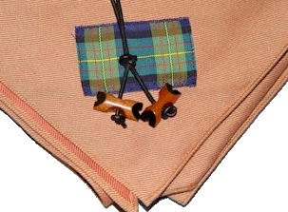

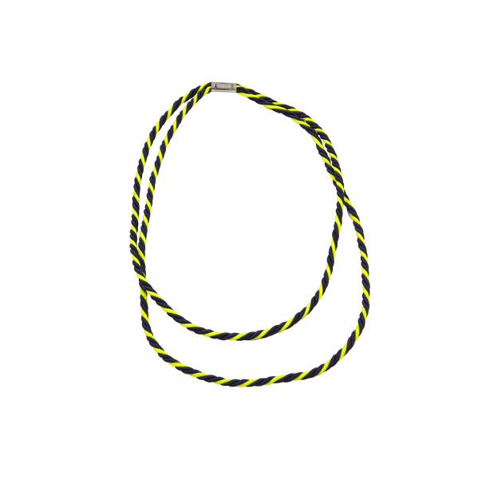

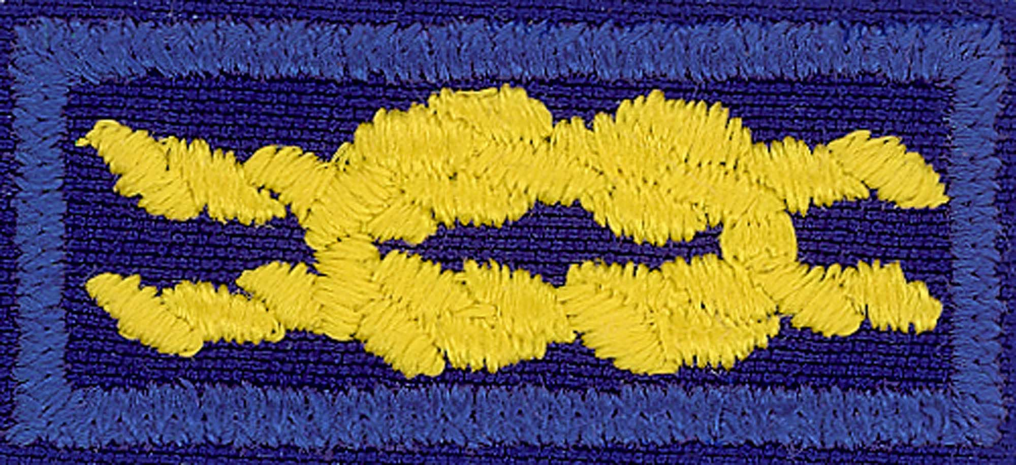
Non-verbal Communication
Notes:
Some of these examples are non-verbal or unspoken forms of communication.
Den chiefs: Discuss with the den what messages these Scouting America examples (above)
convey and what aspects make them effective, or not.

Slide 7
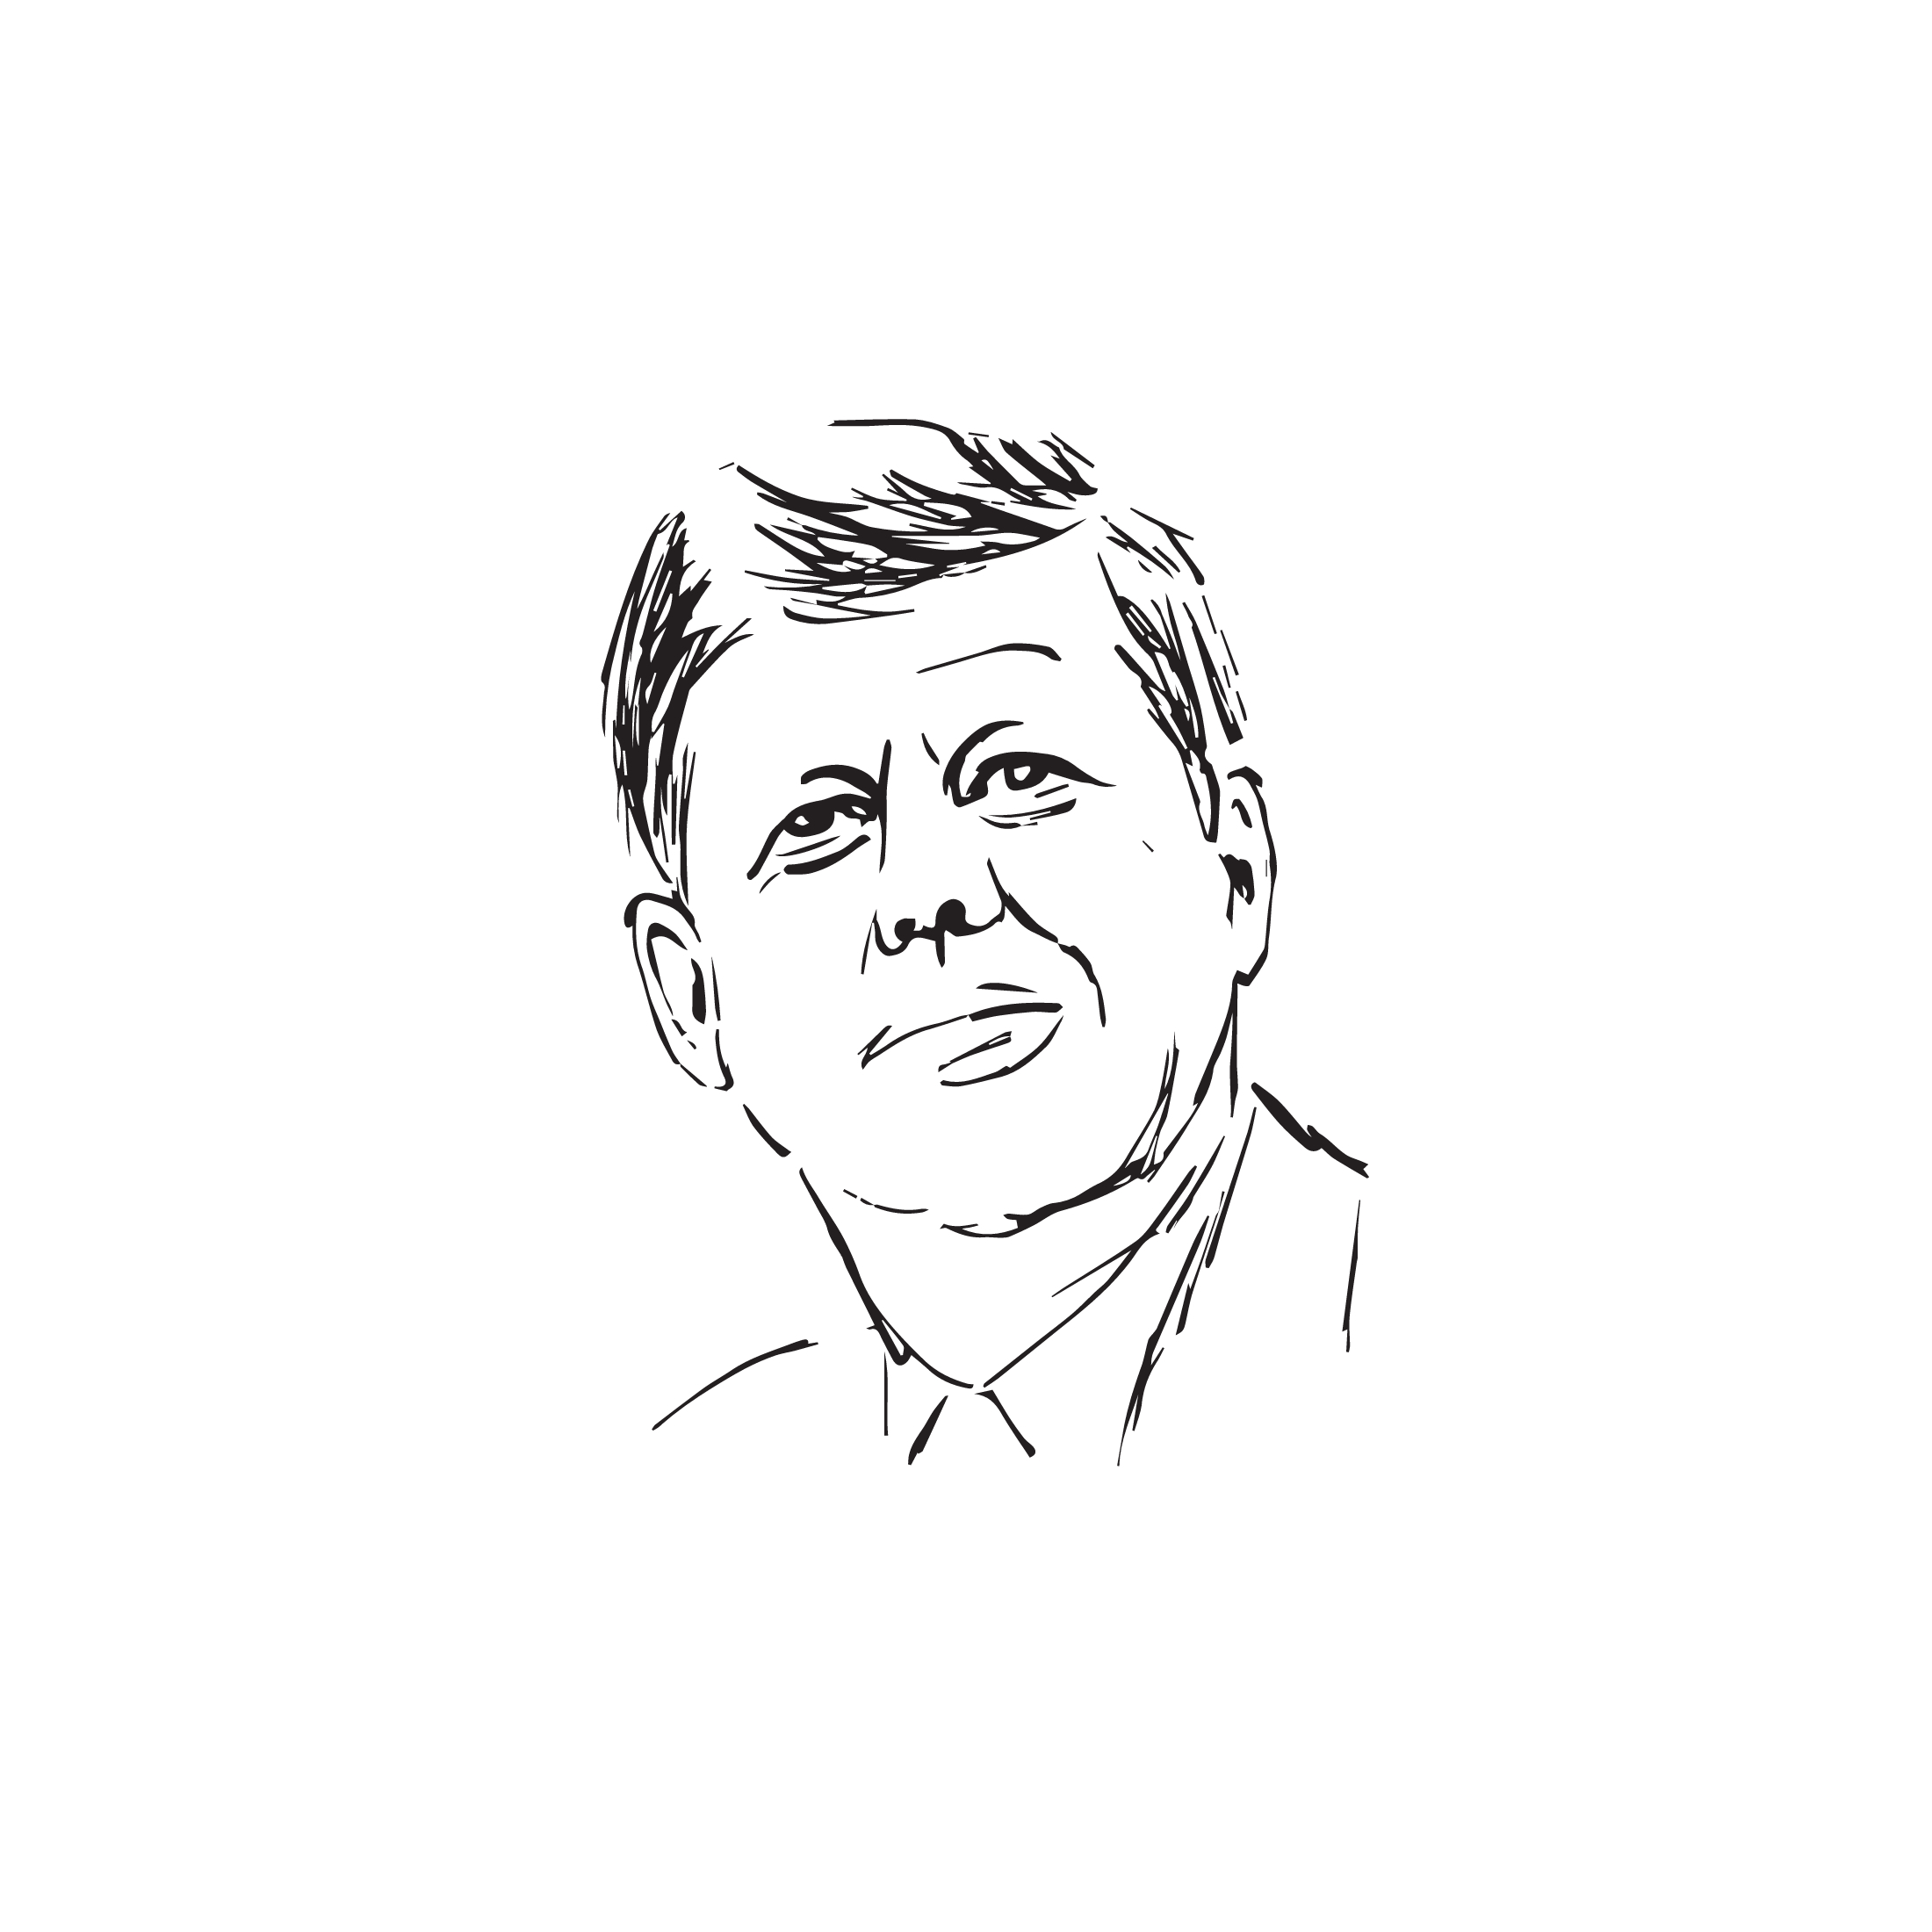

Drive Vision, Mission & Values
Notes:
Discuss the session Drive Vision, Mission, and Values:
“We observed President John F. Kennedy deliver a speech—a form of oral communication.
What aspects of that speech made it so effective?” Encourage a brief sharing of ideas
based on the following:
● Message was important
● Message presented a vision that could affect the lives of the listeners
● Speaker established himself as authoritative
● Speaker believed in what he was presenting
● Speaker got to the point
● Speaker used skills of speaking, body language, tone of voice, and charisma to
make his point
Activity #2: Communication Exercise (~3 minutes)
This is a quick and easy activity that shows how the same instructions can be interpreted
differently by different people and highlights the importance of clear communication. It
should not be allowed to take more than about three minutes.
Directions:
1. Give one sheet of letter size/A4 paper to each participant.
2. Tell the group that you will start giving them all instructions on how to fold the paper
to create a shape (may be a paper airplane or other object created from the folded
paper.)
3. Tell the group that while you give them the instructions, they must keep their eyes
closed and cannot ask any questions.
4. Start giving the group several instructions to fold and rip their paper several times
then ask them to unfold their papers and compare how they look.
Debrief and Discussion:
Make the point that each paper looks different even though you have given the same
instructions to everybody. What does this mean?
Ask the group if they think the results would have been better if they had kept their eyes
open or were allowed to ask questions.
Communicating clearly is not easy, as we all interpret the information we get differently.
That’s why it’s very important to ask questions and confirm understanding to ensure the
message is received and understood as intended.

Slide 8

Barriers
Notes:
Den chiefs: Initiate a discussion with the den about potential barriers to effective
communication. You might use a question such as “What are other potential barriers to
effective communication?” Listed below are suggestions that you can share if the group
does not mention them. Refer to some of them briefly if they are not mentioned, but do
not feel the need to address all or even most of them.
● Personal biases and judgments—we have preconceived notions
● Noise in our environment—telephones, computers, television, people
● Noise in our heads—what to cook for dinner, where the children need to be, what the
boss needs, a difficult conversation to be had
● Non-verbal communication—uncontrolled body language
● Tone of voice
● Lack of clarity—the inability to be clear and concise
● Poor listening skills
● Making assumptions without facts
● Language/cultural differences
● Lack of common ground, what we can agree on
● Assuming that everyone thinks like we do
Next, ask participants to share some of the communication barriers they have experienced in
their work lives or Scouting lives.
Listed below are suggestions that you can share if the group does not mention them. Once
again, refer to a few of them as appropriate, but do not spend much time on these
examples.
● Rushing to help or solve the problem without fully listening
● Technology is unavailable
● Blended families
● Heavy use of acronyms
● Emoji meanings
● Generational barriers
● Virtual teams
● Inappropriate communication technique for age group
● Misunderstandings that remain unresolved
Debrief:
● What might be some effective strategies to use in your Scouting units to alleviate
barriers?
● What are the barriers that you would like to work on as a leader? (Ask them to make
note of these in their personal notebooks. This is an important step, so do not
skip it.)
One of tomorrow’s presentations, Learn to Listen, Listen to Learn, will help to connect the dots
on these communication concepts. Good communication begins with good listening on
the part of the receiver and on the part of the sender. Both the sender and the receiver
have responsibilities to make effective communication happen.

Slide 9
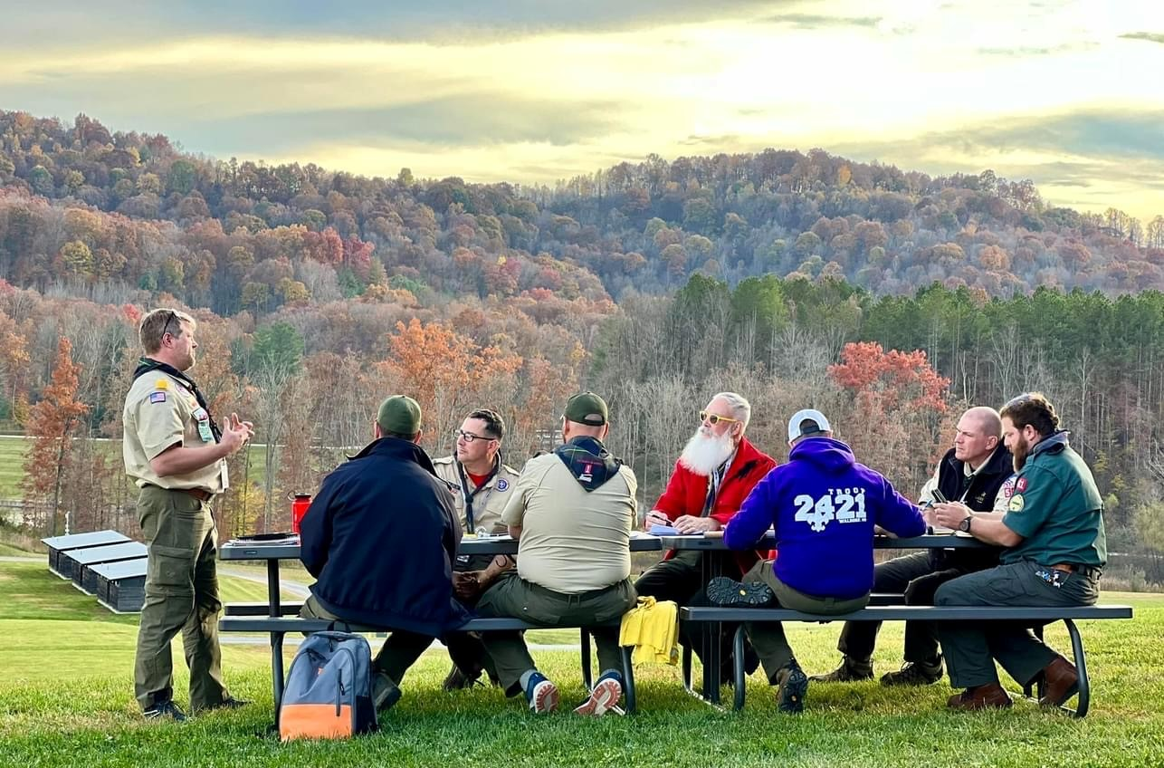
Group Discussion
Notes:
Ask: “What are some ways to assure we communicate effectively?” Get some ideas on the
table, then introduce the following four ways on a chart. Take each in turn, ask for input
on each of them, and discuss what they might mean. This is another potential time sink,
but because it is also an important component of this session, spend an appropriate
amount of time on these topics.

Slide 10

Some Ideas
Find Common Ground
Be Sincere
Establish Authority
Communicate Clearly
Notes:
Establish Common Ground
Den chiefs: For discussion, ask participants what they think it means to find common ground,
and if they can think of any examples of how this technique has worked for them.
Later today, you will experience another Wood Badge presentation, “Include and Optimize
Diverse Talent,” and within your den/patrol, you will play the “Getting to Know You”
game. These will be opportunities for you to think about valuing the diverse makeup of
your team and to learn about each other. It is important to also reflect on the diversity of
individuals in your Scouting unit back home and seek ways to be inclusive and
appreciate their talents.
The more we know about one another, the greater the common experience that we share, and
the easier communication becomes.
Be Sincere
Sincerity can make a difference in our efforts to communicate with others. A speaker must care
about the message and care about the receiver of that message. Otherwise, there is no
point in passing it along.
Establish Authority
A speaker should know what they are talking about. There may be times when a speaker is not
an expert in a subject. What becomes important then is the willingness to learn along
with a group. For example, a Scout leader who knows nothing about constellations can
bring a star chart along on a campout. “I can’t tell the difference between the Big Dipper
and the moon,” they explain, “but I’d sure like to learn. Let’s figure this out together.”
In order to avoid losing credibility, a speaker should learn to be comfortable saying, “I don’t
know the answer, but I will find out.”
While their technical skill in this area may not be high, ability as a communicator permits them to
maintain authority while engaging Scouts in an interesting and worthwhile learning
experience.
Communicate Clearly
Speakers who care about their messages and care about their audiences are likely to
communicate clearly. Communicating clearly includes using words, volume, and pace
that your audience can understand. Don’t use big, fancy words if a simpler explanation is
all you need to get the message across. For certain subjects, communicating clearly can
also include effective visual aids, because not everyone gets the message most clearly
through listening. If you deliberately try to hide part of a message or twist the truth, you
will create fuzziness and confusion, and you might lose the listener’s trust.

Slide 11

Communication…
Tool of leadership
Essential to effective teams
“Common ground”
Clear and concise
Written, verbal, nonverbal, and virtual
Notes:
Communication:
● Is a tool of leadership.
● Is essential to effective teams.
● Happens in the “common ground.”
● Should be clear and concise.
● May be written, verbal, nonverbal, and virtual.

Slide 12
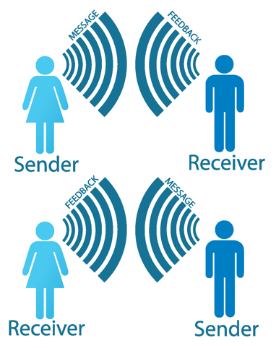
Key Points
Notes:
Other key points to remember:
● Sender and receiver must consider each other.
● Virtual communication can be powerful and has an immediate impact.
● Leaders should consider the challenges people face in communicating.
● Leaders should recognize the barriers that block effective communication.
● Consider the needs of the group with which communication is desired.

Slide 13

Also…
Recognize the barriers
Consider the needs of the group

Slide 14
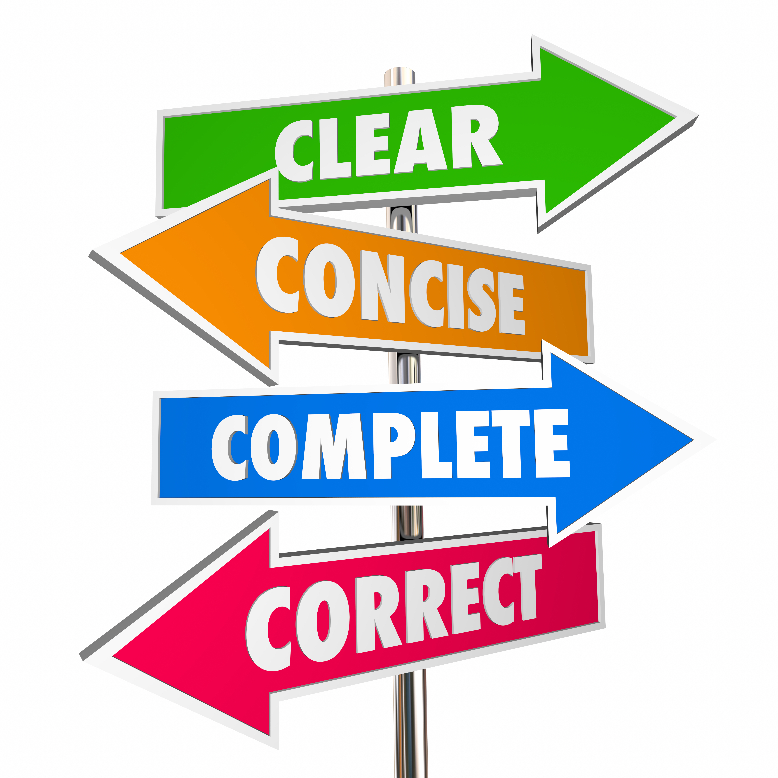
Conclusion
Notes:
Great Leaders are Great Communicators

Slide 15

Reflection
Notes:
Den chiefs: Ask the group:
1. Share what you are taking away from this session that could be useful for your
tickets.
2. Is there a communication technique that could help you achieve one of the ticket
goals you have in mind?
3. Are any of you thinking of goals that relate to communication?
Remind them that the skill of effective communication is another “tool” for their leadership
toolbox. Mention and show the tool for this session again (linked paper cups).

Slide 16
Image appearing on Slide 3—“An impromptu telephone made of bright paper glasses with a rope on a brown background”—is used with Adobe Stock standard license. Image credit: DENIS – stock.adobe.com.

